Slide 1

Complex Decisions: Sequential Interactions

Slide 2
cf. Dynamic Programming
T
T
T
T
T
T
T
T
T
T
T
T
T

Slide 3
Simple Monte Carlo
T
T
T
T
T
T
T
T
T
T
T
T
T
T
T
T
T
T
T
T

Slide 4
Simplest TD Method
T
T
T
T
T
T
T
T
T
T
T
T
T
T
T
T
T
T
T
T

Slide 5

Sarsa
again, need Q(s,a), not just V(s)
control
start with a random policy
update Q and π after each step
again, need ε-soft policies
r_{t}
r_{t+1}
s_{t}
a_{t}
s_{t+1}
a_{t+1}
s_{t+2}
a_{t+2}

Slide 6

Q-learning
previous algorithms: on-policy algorithms
start with a random policy, iteratively improve
converge to optimal
Q-learning: off-policy
use any policy to estimate Q
Q directly approximates Q* (Bellman optimality eqn)
independent of the policy being followed
only requirement: keep updating each (s,a) pair
Sarsa (on-policy)

Slide 7
State representation
pole-balancing
move car left/right to keep the pole balanced
state representation
position and velocity of car
angle and angular velocity of pole
what about Markov property?
would need more info
noise in sensors, temperature, bending of pole
solution
coarse discretization of 4 state variables
left, center, right
totally non-Markov, but still works

Slide 8

Function approximation
until now, state space small and discrete
represent V_{t} as a parameterized function
linear regression, decision tree, neural net, …
update parameters instead of entries in a table
better generalization
fewer parameters and updates affect “similar” states as well
TD update
treat as one data point for regression
want method that can learn on-line (update after each step)

Slide 9
Designing rewards
robot in a maze
episodic task, not discounted, +1 when out, 0 for each step
chess
GOOD: +1 for winning, -1 losing
BAD: +0.25 for taking opponent’s pieces
high reward even when lose
rewards
rewards indicate what we want to accomplish
NOT how we want to accomplish it
shaping
positive reward often very “far away”
rewards for achieving subgoals (domain knowledge)
also: adjust initial policy or initial value function
Notes:
maybe show the pendulum?

Slide 10
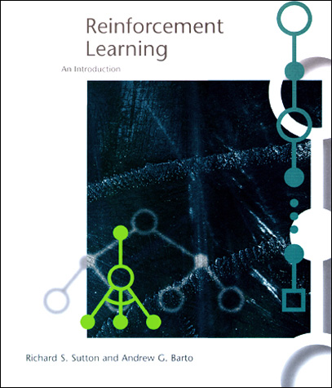
www.cs.ualberta.ca/~sutton/book/the-book.html

